Slide 1
EXPLORING (& PLOTTING) NUMERICAL AND CATEGORICAL DATA

Slide 2
BOX PLOTS
is an extremely effective mechanism to get a one-shot view and understand the nature of the data.
Also called as whisker plot
gives a standard visualization of the five-number summary statistics of a data, namely minimum, first quartile (Q1), median (Q2), third quartile (Q3), and maximum

Slide 3
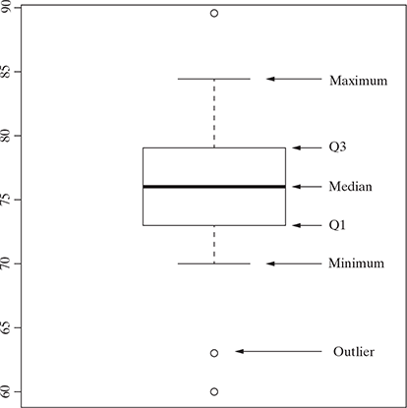
BOX PLOTS
The central rectangle or the box spans from first to third quartile (i.e. Q1 to Q3), thus giving the inter-quartile range (IQR).
Median is given by the line or band within the box.
The lower whisker extends up to 1.5 times of the inter-quartile range (or IQR) from the bottom of the box, i.e. the first quartile or Q1.
The upper whisker extends up to 1.5 times of the inter-quartile range (or IQR) from the top of the box, i.e. the third quartile or Q3.
The data values coming beyond the lower or upper whiskers are the ones which are of unusually low or high values respectively.
These are the outliers, which may deserve special consideration.

Slide 4
LOWER WHISKER BOX PLOTS
The lower whisker extends up to 1.5 times of the inter-quartile range (or IQR) from the bottom of the box, i.e. the first quartile or Q1.
However, the actual length of the lower whisker depends on the lowest data value that falls within (Q1 − 1.5 times of IQR).
Say for a specific set of data, Q1 = 73, median = 76 and Q3 = 79.
  Hence, IQR will be 6 (i.e. Q3 – Q1).
So, lower whisker can extend maximum till (Q1 – 1.5 × IQR) = 73 – 1.5 × 6 = 64.
However, say there are lower range data values such as 70, 63, and 60.
So, the lower whisker will come at 70 as this is the lowest data value larger than 64.

Slide 5
UPPER WHISKER BOX PLOTS
The upper whisker extends up to 1.5 as times of the inter-quartile range (or IQR) from the top of the box, i.e. the third quartile or Q3.
Similar to lower whisker, the actual length of the upper whisker will also depend on the highest data value that falls within (Q3 + 1.5 times of IQR).
For the same set of data mentioned in the above point, upper whisker can extend maximum till (Q3 + 1.5 × IQR) = 79 + 1.5 × 6 = 88.
If there is higher range of data values like 82, 84, and 89.
So, the upper whisker will come at 84 as this is the highest data value lower than 88.

Slide 6
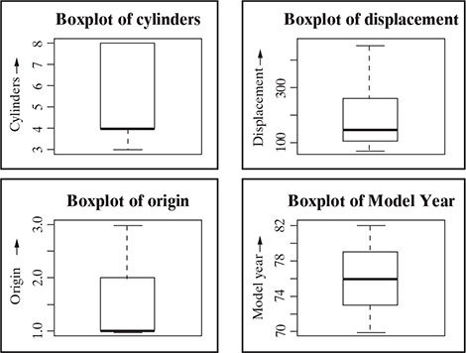
BOX PLOT OF AUTO MPG ATTRIBUTES

Slide 7
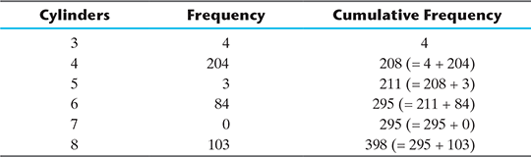
FREQUENCY OF “CYLINDERS” ATTRIBUTE
Since the total frequency is 398, the first quartile (Q1), median (Q2), and third quartile (Q3) will be at a cumulative frequency 99.5 (i.e. average of 99th and 100th observation), 199 and 298.5 (i.e. average of 298th and 299th observation), respectively. This way Q1 = 4, median = 4 and Q3 = 8.

Slide 8
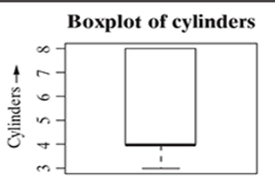
ANALYSING BOXPLOT OF CYLINDERS
Since there is no data value beyond 8, there is no upper whisker.
Also, since both Q1 and median are 4, the band for median falls on the bottom of the box.
Same way, though the lower whisker could have extended till -2 (Q1 – 1.5 × IQR = 4 – 1.5 × 4 = –2), in reality, there is no data value lower than 3. Hence, the lower whisker is also short.

Slide 9
HISTOGRAM
Histogram is another plot which helps in effective visualization of numeric attributes.
It helps in understanding the distribution of a numeric data into series of intervals, also termed as ‘bins’.
The histogram is composed of a number of bars, one bar appearing for each of the ‘bins’.
The height of the bar reflects the total count of data elements whose value falls within the specific bin value, or the frequency.
Difference between histogram and box plot is
  The focus of histogram is to plot ranges of data values (acting as ‘bins’), the number of data elements in each range will depend on the data distribution. Based on that, the size of each bar corresponding to the different ranges will vary.
  The focus of box plot is to divide the data elements in a data set into four equal portions, such that each portion contains an equal number of data elements.

Slide 10
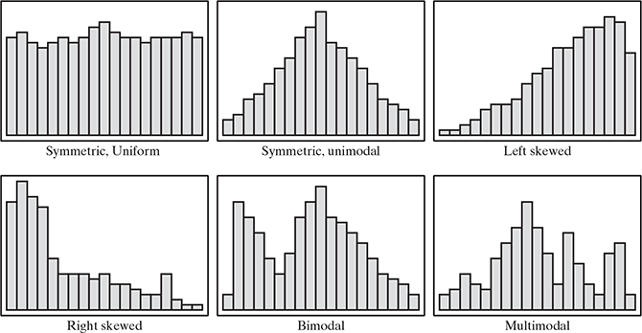
DIFFERENT SHAPES OF HISTOGRAMS DEPENDING ON THE NATURE OF THE DATA, E.G. SKEWNESS

Slide 11
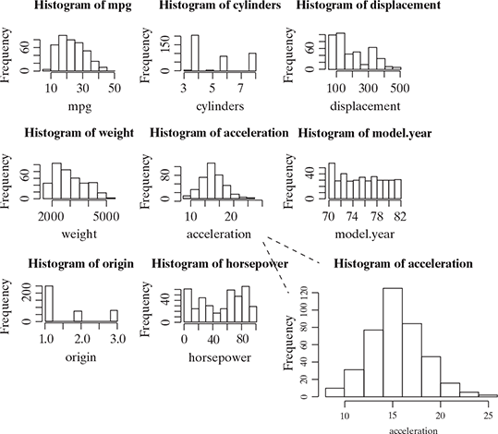
HISTOGRAM AUTO MPG ATTRIBUTES
The histograms for ‘mpg’ and ‘weight’ are right-skewed.
The histogram for ‘acceleration’ is symmetric and unimodal,
The histogram for ‘model.year’ is symmetric and uniform.
For the remaining attributes, histograms are multimodal in nature.

Slide 12
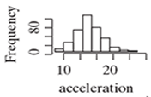
HISTOGRAM OF ACCELERATION
Each ‘bin’ represents an acceleration value interval of 2 units.
So the second bin, e.g., reflects acceleration value of 10 to 12 units.
The corresponding bar chart height reflects the count of all data elements whose value lies between 10 and 12 units.
Also, it is evident from the histogram that it spans over the acceleration value of 8 to 26 units.
The frequency of data elements corresponding to the bins first keep on increasing, till it reaches the bin of range 14 to 16 units. At this range, the bar is tallest in size.
So we can conclude that a maximum number of data elements fall within this range.
After this range, the bar size starts decreasing till the end of the whole range at the acceleration value of 26 units.

Slide 13
when the histogram is uniform, as in the case of attribute ‘model. year’, it gives a hint that all values are equally likely to occur.

Slide 14
EXPLORING CATEGORICAL DATA
how many unique names are there for the attribute ‘car name’ or how many unique values are there for ‘cylinders’ attribute.
For attribute ‘car name’
  Chevrolet chevelle malibu
  Buick skylark 320
  Plymouth satellite
  Amc rebel sst
  Ford torino
  Ford galaxie 500
  Chevrolet impala
  Plymouth fury iii
  Pontiac catalina
  Amc ambassador dpl
For attribute ‘cylinders’
  8 4 6 3 5

Slide 15
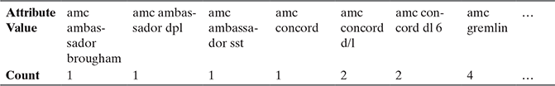
EXPLORING CATEGORICAL DATA
to get a table consisting the categories of the attribute and count of the data elements falling into that category.
Count of Categories for ‘car name’ Attribute
Count of Categories for ‘Cylinders’ Attribute

Slide 16
EXPLORING CATEGORICAL DATA
to know the proportion (or percentage) of count of data elements belonging to a category.
  Say, e.g., for the attributes ‘cylinders’, the proportion of data elements belonging to the category 4 is 204 ÷ 398 = 0.513, i.e. 51.3%.

Slide 17
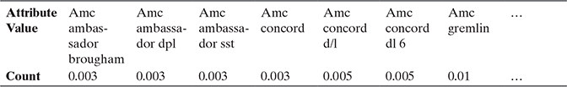

EXPLORING CATEGORICAL DATA
Proportion of Categories for “car name” Attribute
Proportion of Categories for “Cylinders” Attribute

Slide 18
MODE: CATEGORICAL ATTRIBUTES
“mode” is applicable on categorical attributes.
Like mean and median, mode is also a statistical measure for central tendency of a data.
Mode of a data is the data value which appears most often
For cylinders, since the number of categories is less, we can see that the mode is 4
For car name, the mode is the category ‘ford pinto’ for which frequency is of highest value 6.

Slide 19
EXPLORING RELATIONSHIP BETWEEN VARIABLES
A scatter plot helps in visualizing bivariate relationships, i.e. relationship between two variables.
For example, in a data set there are two attributes – attr_1 and attr_2.
We want to understand the relationship between two attributes, i.e.
  with a change in value of one attribute, say attr_1, how does the value of the other attribute, say attr_2, changes.
We can draw a scatter plot, with attr_1 mapped to x-axis and attr_2 mapped in y-axis.
So, every point in the plot will have value of attr_1 in the x-coordinate and value of attr_2 in the y-coordinate.
As in a two-dimensional plot, attr_1 is said to be the independent variable and attr_2 as the dependent variable.

Slide 20
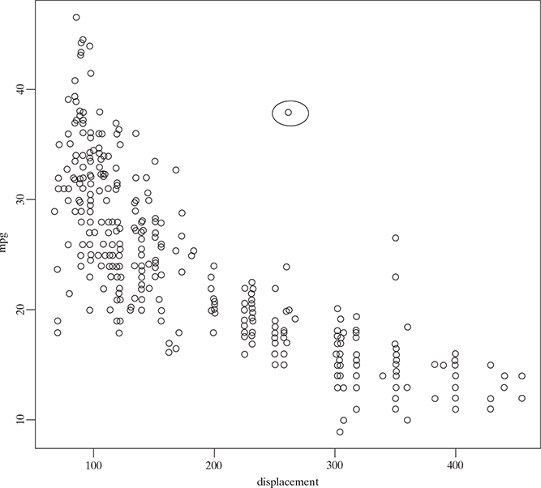
SCATTER PLOT OF ‘DISPLACEMENT’ AND ‘MPG’
The value of ‘mpg’ seems to steadily decrease with the increase in the value of ‘displacement’
it can be reviewed by calculating the correlation between the variables.
An indication of presence of outlier data values.
  there is one data element which has a mpg of 37 for a displacement of 250.
  This record is completely different from other data elements having similar displacement value but mpg value in the range of 15 to 25.

Slide 21
TWO-WAY CROSS-TABULATIONS
Two-way cross-tabulations (also called cross-tab or contingency table) are used to understand the relationship of two categorical attributes in a concise way.
It has a matrix format that presents a summarized view of the bivariate frequency distribution.
A cross-tab, very much like a scatter plot, helps to understand how much the data values of one attribute changes with the change in data values of another attribute.

Slide 22
Let’s assume the attributes ‘cylinders’, ‘model.year’, and ‘origin’ as categorical and try to examine the variation of one with respect to the other.
A ‘cylinders’ reflects the number of cylinders in a car and assumes values 3, 4, 5, 6, and 8.
Attribute ‘model.year’ captures the model year of each of the car
Attribute ‘origin’ gives the region of the car, the values for origin 1, 2, and 3 corresponding to North America, Europe, and Asia.

Slide 23
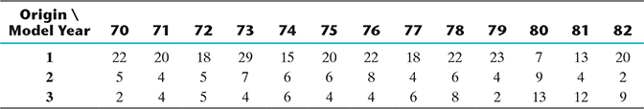
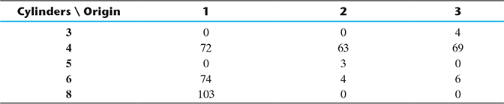
CROSS-TABS
help us understand the number of vehicles per year in each of the regions North America, Europe, and Asia.
it gives the number of 3, 4, 5, 6, or 8 cylinder cars in every region present in the sample data set.
Cross-tab for ‘Model year’ vs. ‘Origin’
Cross-tab for ‘Cylinders’ vs. ‘Origin’

Slide 24
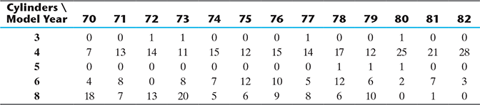
CROSS-TAB
presents the number of 3, 4, 5, 6, or 8 cylinder cars every year.
Cross-tab for ‘Cylinders’ vs. ‘Model year’

Slide 25
DATA QUALITY AND REMEDIATION
Data quality
  missing value
  Outliers
Reasons
  Incorrect sample set selection
  Errors in data collection
Data remediation
  by proper sampling technique
  Handling outliers
  Handling missing values

Slide 26
HANDLING OUTLIERS
Remove outliers: If the number of records which are outliers is not many, a simple approach may be to remove them.
Imputation:
  Imputation is a method to assign a value to the data elements having outliers.
  One other way is to impute the value with mean or median or mode.
  The value of the most similar data element may also be used for imputation.
Capping: For values that lie outside the 1.5|×| IQR limits, we can cap them by replacing those observations below the lower limit with the value of 5th percentile and those that lie above the upper limit, with the value of 95th percentile.

Slide 27
HANDLING MISSING VALUES
Eliminate records having a missing value of data elements
Imputing missing values
  assign a value to the data elements having missing values.
  Mean/mode/median is most frequently assigned value.
    For quantitative attributes
      all missing values are imputed with the mean, median, or mode of the remaining values under the same attribute.
    For qualitative attributes
      all missing values are imputed by the mode of all remaining values of the same attribute.
  However, another strategy may be identify the similar types of observations whose values are known and use the mean/median/mode of those known values.
Estimate missing values

Slide 28
HANDLING MISSING VALUES
Estimate missing values
  If there are data points similar to the ones with missing attribute values, then the attribute values from those similar data points can be planted in place of the missing value.
  For finding similar data points or observations, distance function can be used.
  For example, let’s assume that the weight of a Russian student having age 12 years and height 5 ft. is missing.
    Then the weight of any other Russian student having age close to 12 years and height close to 5 ft. can be assigned.

Slide 29
POPULAR DATASETS
Iris flower data set | Contains various class of flowers
MNIST database | Images of handwritten digits commonly used to test classification, clustering, and image processing algorithms
ImageNet | Images of 1000 categories
Twitter Sentiment Analysis Dataset | Text data, emoji
BBC News Datasets, Amazon Reviews Dataset YouTube Dataset UCI machine learning repository | Text data Video data classification

Slide 30
DATA MATRIX
To be analyzable with statistical tools, data needs to be presented as a rectangular data matrix
Each column in a data matrix contains a variable (indicator, mesurement, questions in a survey...) and each row an observation(response)

Slide 31
Schematic representation of a Data Matrix
Country | Continent | ContNum | GDPperCapita | Variablei
Afghanistan | Asia | 1 | value | value
Albania | Europe | 3 | value | value
... | ... | .... | .... | ....
countryn | ... | value | value | value

Slide 32
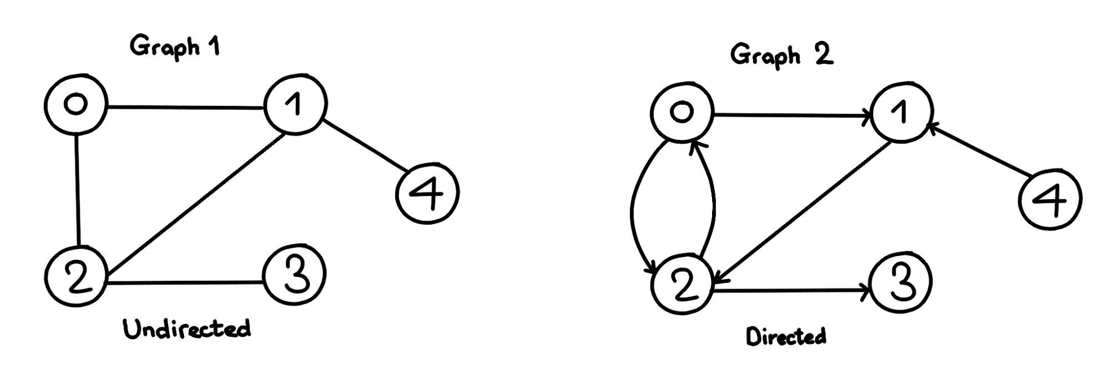
GRAPH DATA
A graph data structure consists of a finite (and possibly mutable) set of vertices (also called nodes or points), together with a set of unordered pairs of these vertices for an undirected graph or a set of ordered pairs for a directed graph

Slide 33
GRAPH BASED DATA MINING
Graph mining is central to web mining because the web links form a huge graph and mining its properties has a large significance.
Graph data mining is used to discover useful information and knowledge from graph data.

Slide 34
DOCUMENT TERM MATRIX
A document-term matrix is a mathematical matrix that describes the frequency of terms that occur in a collection of documents
It is also common to encounter the transpose, or term-document matrix where documents are the columns and terms are the rows
They are useful in the field of natural language processing and computational text analysis

Slide 35
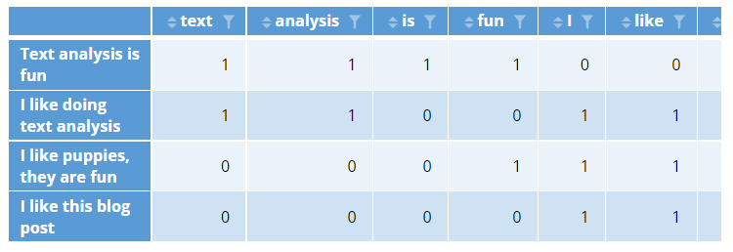
DOCUMENT TERM MATRIX - EXAMPLE

Slide 36
SEQUENTIAL DATA
Whenever the points in the dataset are dependent on the other points in the dataset the data is said to be Sequential data.
A common example of this is a Timeseries such as a stock price or a sensor data where each point represents an observation at a certain point in time.
Human action recognition from video data ??? Is this sequential data ?

Slide 37
SPARSE DATA MATRIX
A sparse matrix is a matrix that is comprised of mostly zero values.
An example of a smaller sparse matrix might be a word or term occurrence matrix for words in one book against all known words in English.
This is clearly a waste of memory resources as those zero values do not contain any information.

Slide 38
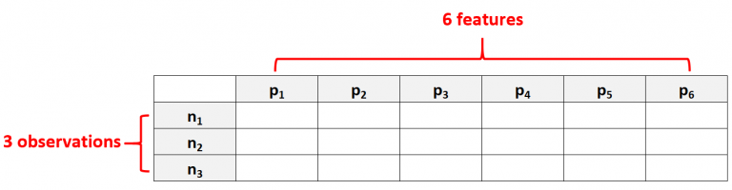
WHAT IS HIGH DIMENSIONAL DATA?
High dimensional data refers to a dataset in which the number of features p is larger than the number of observations N, often written as p >> N
For example, a dataset that has p = 6 features and only N = 3 observations would be considered high dimensional data because the number of features is larger than the number of observations

Slide 39
WHAT IS NOT HIGH DIMENSIONALITY
One common mistake people make is assuming that “high dimensional data” simply means a dataset that has a lot of features
That’s incorrect. A dataset could have 10,000 features, but if it has 100,000 observations then it’s not high dimensional.

Slide 40
WHY IS HIGH DIMENSIONAL DATA A PROBLEM?
When the number of features in a dataset exceeds the number of observations, we will never have a deterministic answer
It becomes impossible to find a model that can describe the relationship between the predictor variables and the response variable
because we don’t have enough observations to train the model on

Slide 41
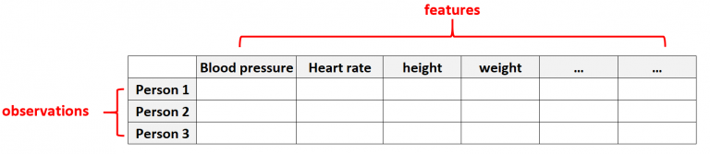
EXAMPLES OF HIGH DIMENSIONAL DATA
EXAMPLE 1: HEALTHCARE DATA
High dimensional data is common in healthcare datasets where the number of features for a given individual can be massive (i.e. blood pressure, resting heart rate, immune system status, surgery history, height, weight, existing conditions, etc.)
In these datasets, it’s common for the number of features to be larger than the number of observations

Slide 42
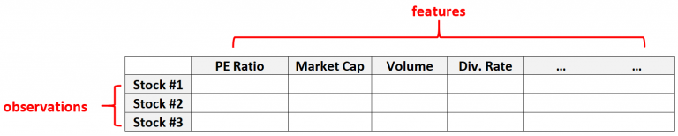
EXAMPLES OF HIGH DIMENSIONAL DATA
EXAMPLE 2: FINANCIAL DATA
Number of features for a given stock can be quite large (i.e. PE Ratio, Market Cap, Trading Volume, Dividend Rate, etc.)
In these datasets, it’s common for the number of features to be larger than the number of observations

Slide 43
ISSUES WITH HIGH-DIMENSIONAL DATA (THE CURSE OF DIMENSIONALITY)
Overfitting (Low biasing and high variance)
Underfitting (High biasing and low variance)
Bias = Training error
Variance= test error
Curse of Dimensionality

Slide 44
HOW TO HANDLE HIGH DIMENSIONAL DATA
There are two common ways to deal with high dimensional data:
Choose to include fewer features
The most obvious way to avoid dealing with high dimensional data is to simply include fewer features in the dataset
Drop features with many missing values
Drop features with low variance
Drop features with low correlation with the response variable

Slide 45
HOW TO HANDLE HIGH DIMENSIONAL DATA
2. Use a regularization method
Principal Components Analysis
Principal Components Regression
Ridge Regression
Lasso Regression
https://www.youtube.com/watch?v=OFyyWcw2cyM
https://github.com/krishnaik06/Dimesnsionality-Reduction/blob/master/01-Principal%20Component%20Analysis.ipynb

Slide 46

PRACTICAL SESSION OF WEKA SOFTWARE FOR DATA MINING ON IRIS DATASET

Slide 47
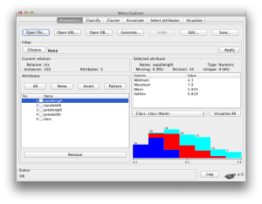
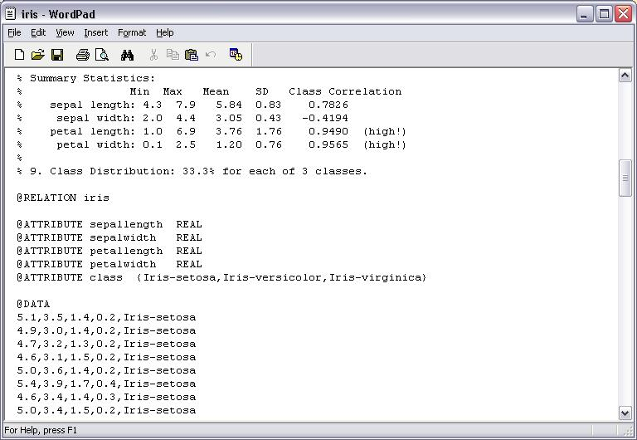
WEKA – IRIS ARFF FILE AND CLASSIFICATION

